Slide 1




LayoutLMv3
Invoice data
Extraction

Slide 2

PROBLEM STATEMENT
In industries that handle large volumes of financial documents, such as invoices, manual data extraction is a time-consuming and error-prone process. Companies must extract key information from invoices, including invoice numbers, dates, total amounts, and line items, to process payments, maintain accurate financial records, and ensure compliance. Traditional Optical Character Recognition (OCR) solutions are often inadequate, as they struggle to capture the layout and structure of complex documents like invoices, where context and spatial relationships between entities are critical for accurate data extraction.

Slide 3

VISION
This project aims to address the limitations of traditional OCR systems by fine-tuning LayoutLMv3, a state-of-the-art transformer model, to automatically extract structured data from invoices. LayoutLMv3 leverages both textual and layout information, allowing it to understand the spatial relationships within documents and improve the accuracy of entity extraction. By automating the extraction of key information from invoices, this solution reduces manual effort, minimizes errors, and enhances the efficiency of financial document processing.

Slide 4

OBJECTIVES
Fine-tune LayoutLMv3 on the SERIO dataset, which contains annotated invoices.
Improving the model's ability to recognize structured data from financial documents.
Automate key aspects of financial processing by accurately extracting and labeling relevant invoice data.

Slide 5

SROIE Datasetv2
This dataset was created for the ICDAR 2019 Robust Reading Challenge on Scanned Receipts OCR and Information Extraction (SROIE). The dataset has receipts written in English. The dataset contains 973 scanned receipts. For each receipt you have a .jpg file of the scanned receipt, a .txt file holding OCR information called box and a .txt file holding the key information values called entity.
Train/Dev/Test Split
This dataset was split during the development as following:
626 Training Examples
174 Validation Examples
174 Testing Examples
DATASET

Slide 6
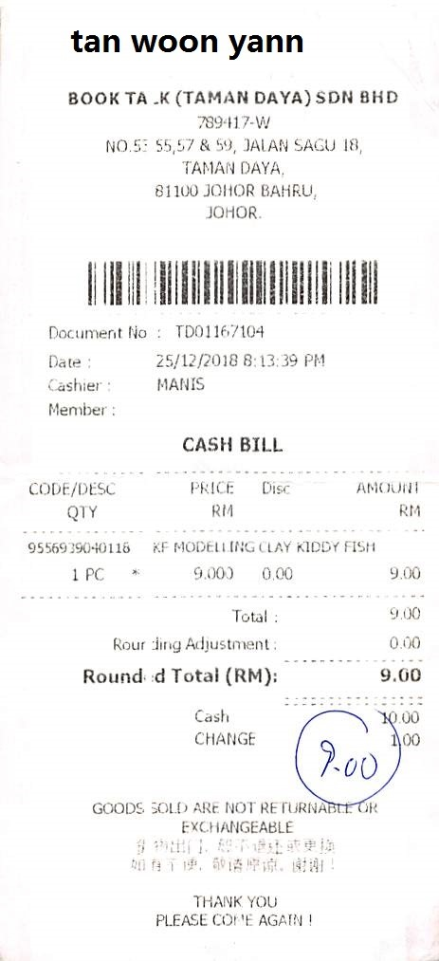
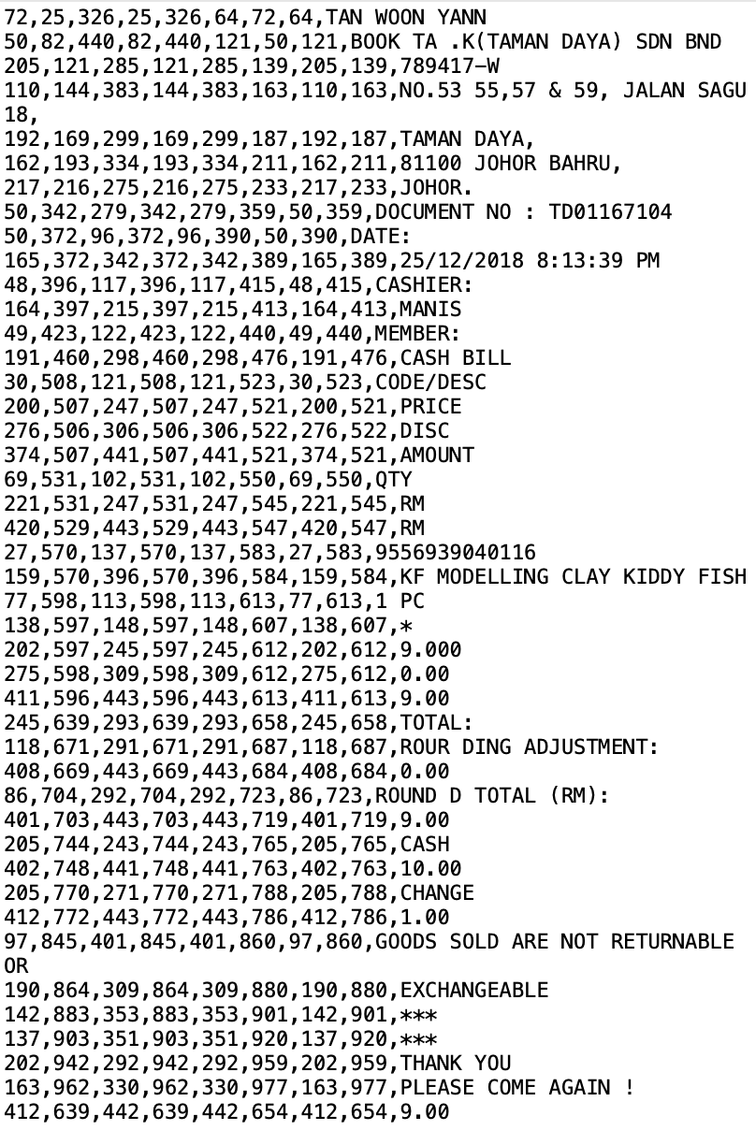
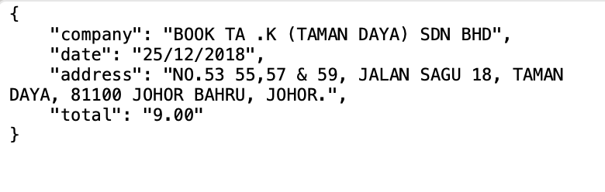
Img
Box
Entity

Slide 7

MODEL OVERVIEW
LayoutLMv3 is a transformer model designed for document image understanding, combining both text and layout information to better process structured documents like invoices, forms, and receipts. It improves on previous versions (LayoutLM, LayoutLMv2) by using a multi-modal approach, integrating textual content with the spatial layout of the text on the page. This allows LayoutLMv3 to excel in tasks where understanding the document’s structure is essential, such as key information extraction and document classification.

Slide 8

1. Data Preprocessing
Image Processing
Bounding Box Extraction
Tokenization
Annotation Formatting
2. Training
Forward Pass
Loss Calculation
Backpropagation
Checkpointing
3. Evaluation
& Testing
We measured the model's performance using the following metrics:
Accuracy: 96.2%
Precision: 95.4%
Recall: 96.2%
F1-Score: 95.8%
METHODOLOGY

Slide 9

MODEL DEPLOYMENT
This project deploys a fine-tuned LayoutLMv3 model to automatically extract key data from invoices. Trained on the SROIE dataset, the model is optimized to recognize important fields such as company names, dates, and totals from invoice images.
The deployment is powered by a Flask-based API where users can upload an invoice image using a user interface for real-time processing. The API handles image preprocessing, tokenization, and bounding box extraction to format the input for the LayoutLMv3 model. After inference, the model returns an image of the invoice with colored boundary boxes and labels as well as a structured JSON output with labeled data as key-value pairs extracted from the document.
The main advantage of this approach is the automation of invoice data extraction, reducing manual data entry and increasing accuracy for tasks like bookkeeping or expense management. This solution is designed to work with both scanned documents and photographed invoices, making it versatile for various use cases in finance and accounting.

Slide 10
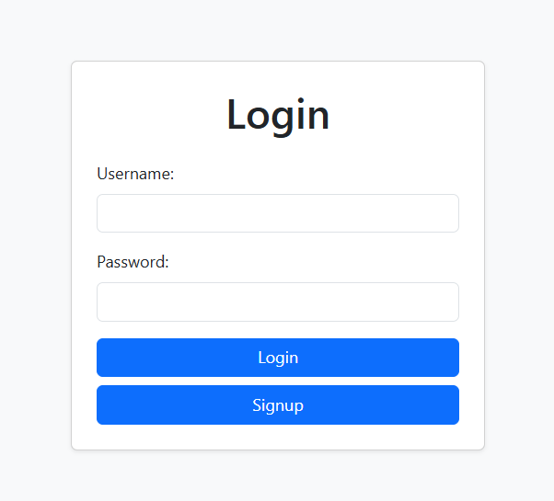
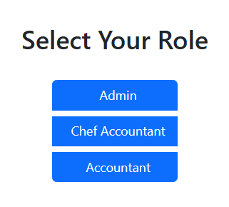
Demo Website

Slide 11
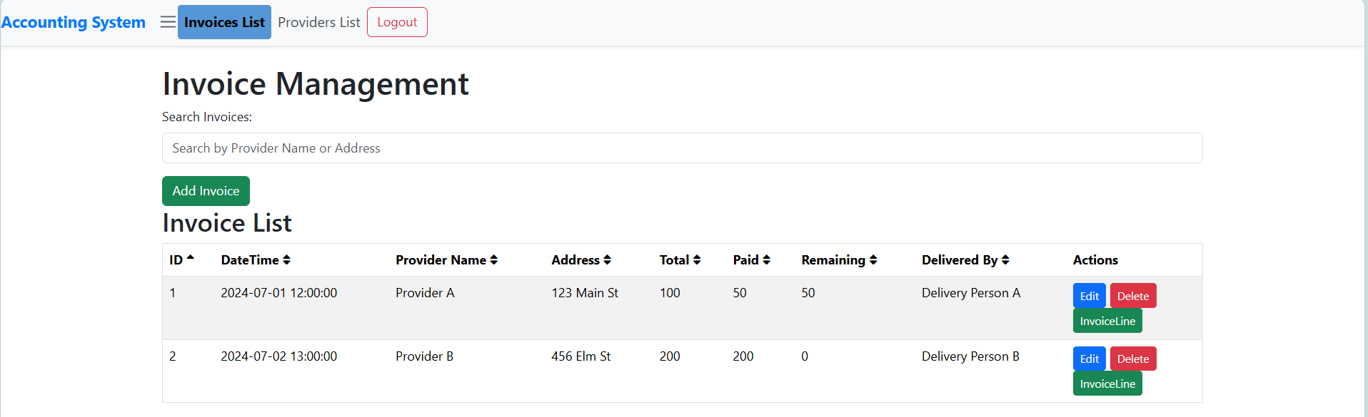
Demo Website

Slide 12

Thank You
Rahma Mohamed
Mohamed Ahmed
Seif Eldeen Sameh

